Slide 1
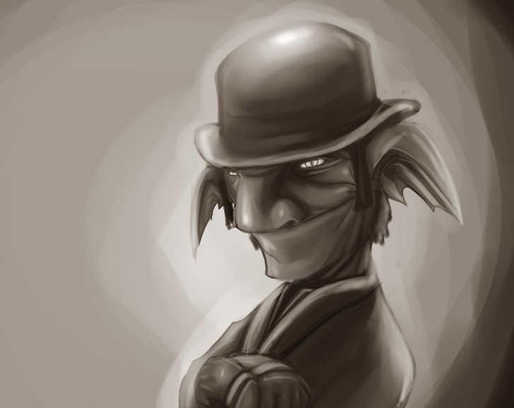
Roswell Investigations & Co.KG
I‘m such a good detective, you don‘t have to find me – i find you.

